Slide 1
Setting up hadoop
yANG GAO

Slide 2
Psudo-distributed cluster
Developing and testing your hadoop program on your own machine before submitting to hadoop cluster is highly recommended.
Refer to http://hadoop.apache.org/docs/current/hadoop-project-dist/hadoop-common/SingleCluster.html for installation documentation

Slide 3
Java installation
Go to http://www.oracle.com/technetwork/java/javase/downloads/jdk8-downloads-2133151.html to download Java SE Development Kit 8u144. Remember to accept agreement and select Linux x64 jdk-8u144-linux-x64.tar.gz
Go to directory where you store the file and enter the command as shown in right figure.

Slide 4
JAVA iNSTALLATION
Rename jdk folder following commands in right figure
Install vim by
sudo apt-get install vim

Slide 5
Java installation
Enter command (vim ~/.profile)
Enter All “export” part in the right figure at the end of this file
Press ESC, then press shift + :
Enter wq, press enter to save changes

Slide 6
Java installation
Source this file according to command in the right figure

Slide 7
JAVA INSTALLATION
Verify your installation.
Restart Ubuntu

Slide 8
hAdoop setup
Install ssh and pdsh
$ sudo apt-get install ssh
$ sudo apt-get install pdsh
Download hadoop http://apache.mirrors.lucidnetworks.net/hadoop/common/hadoop-2.8.1/hadoop-2.8.1.tar.gz
Unzip this tar.gz file using command on right figure
Go to installation directory and rename the folder to hadoop
mv ~/Documents/hadoop-2.8.1/ ~/Documents/hadoop

Slide 9
Hadoop setup
Enter following command in terminal:
vim ~/.profile
Add content marked by red line at end of file
Save and exit
source ~/.profile

Slide 11
CHANGE JAVA_HOME IN HADOOP-ENV.SH

Slide 12
Pseudo-distributed mode
Go to hadoop folder, open core-site.xml
Enter content in the right image
Save and exit

Slide 13
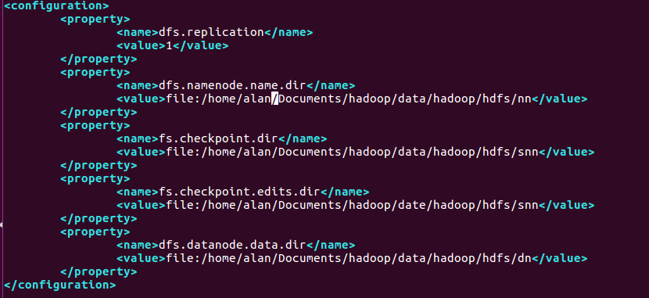
PSEUDO-DISTRIBUTED MODE
Go to hadoop folder, open hdfs-site.xml
Enter content in the right image
Save and exit

Slide 14
PSEUDO-DISTRIBUTED MODE
Ssh to local host
Format namenode
start-dfs.sh

Slide 15
Verification
Browse the web interface for the NameNode; by default it is available at:
NameNode - http://localhost:50070/
Create your own directory

Slide 16
VERIFICATION
USE following command to upload data
Hdfs dfs –put ~/Documents/hadoop/etc/hadoop/*.xml /user/alan/input
Execute following command to start a hadoop task

Slide 17
Check output

Slide 18
You are done
You should execute start-dfs.sh every time you want to start hadoop
Thank you

